Slide 1
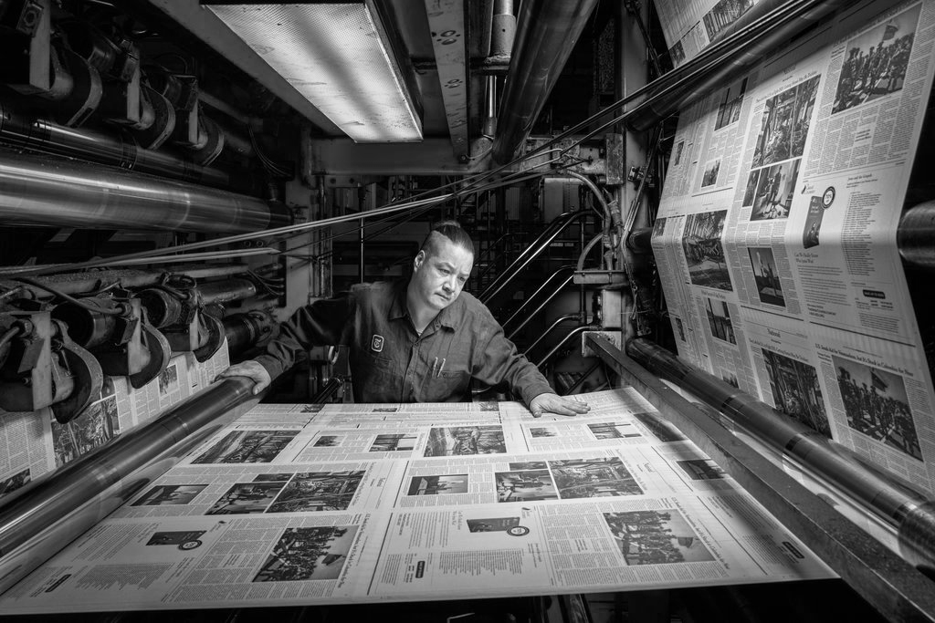
U.S. Newspaper Publishing Industry NLP Analysis
Using natural language processing to EXAMINE issues being faced by a struggling industry

Slide 2
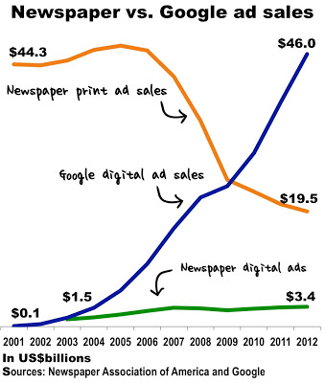
Introduction
Papers initially struggled to adapt to internet age
Industry collapsed in 2006
Subsequent financial crises crippled many papers, small and large
In USD billions
Sources: NAA and Google

Slide 3

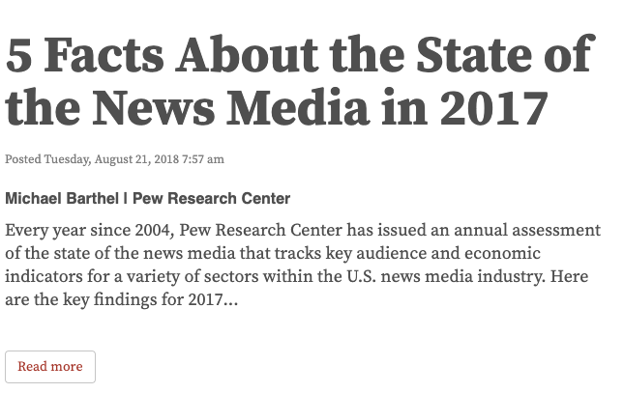
Methodology
GOAL:
investigate newspaper publishing trade magazine articles as a means to analyze key issues facing a struggling industry
PROCESS:
use natural language processing techniques to categorize content types of articles that appear in Editor & Publisher Magazine articles over time and quantify concern with these topics over time

Slide 4
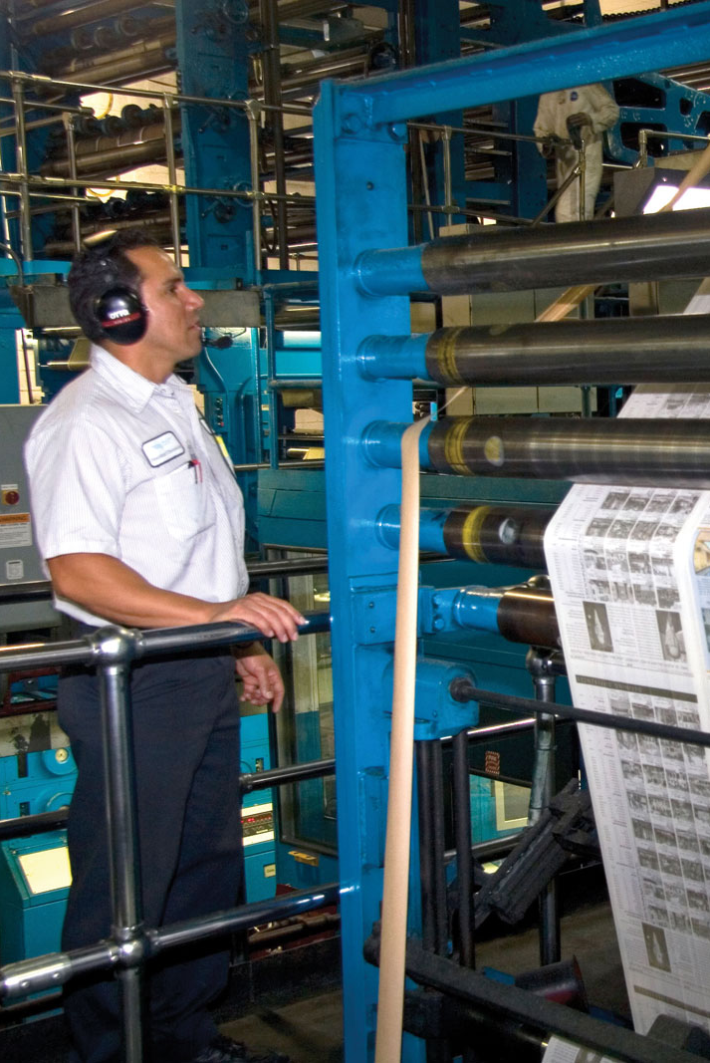
Under the hood
Scraping with BeautifulSoup
Pre-processing with NLTK
Vectorization with TF-IDF (in AWS)
Dimensionality Reduction with NMF (in AWS)
Visualization with Seaborn and Tableau

Slide 5
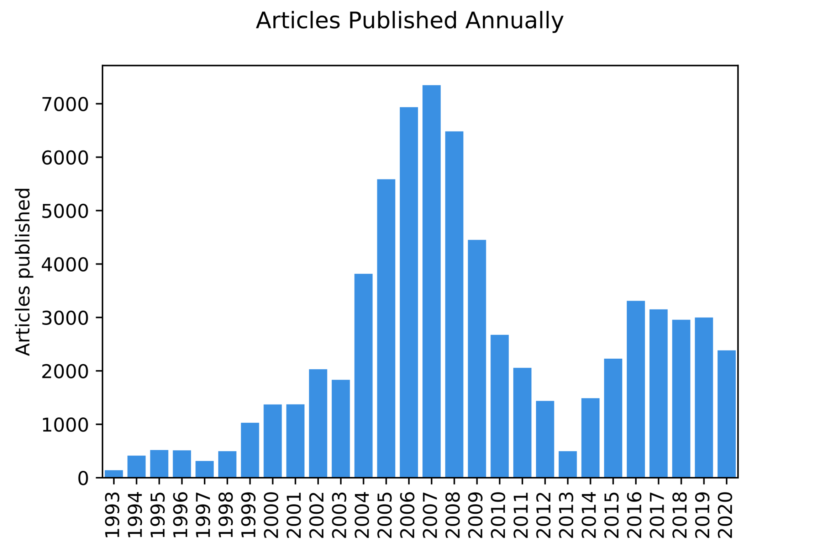
Key Metric: Topic Strength
69,848 articles published over 27 years
Articles categorized according to single strongest topic correlation
Normalized topic distribution data to account for inconsistent annual publishing rate
TOPIC STRENGTH = % of articles per year in each topic

Slide 6
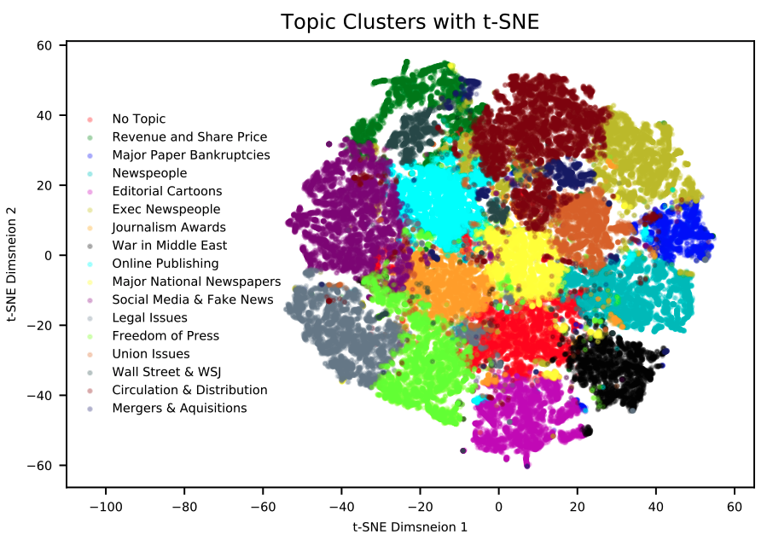
Topic Modeling
All 70k articles were categorized into 17 topics
See appendix for topic breakdown

Slide 7
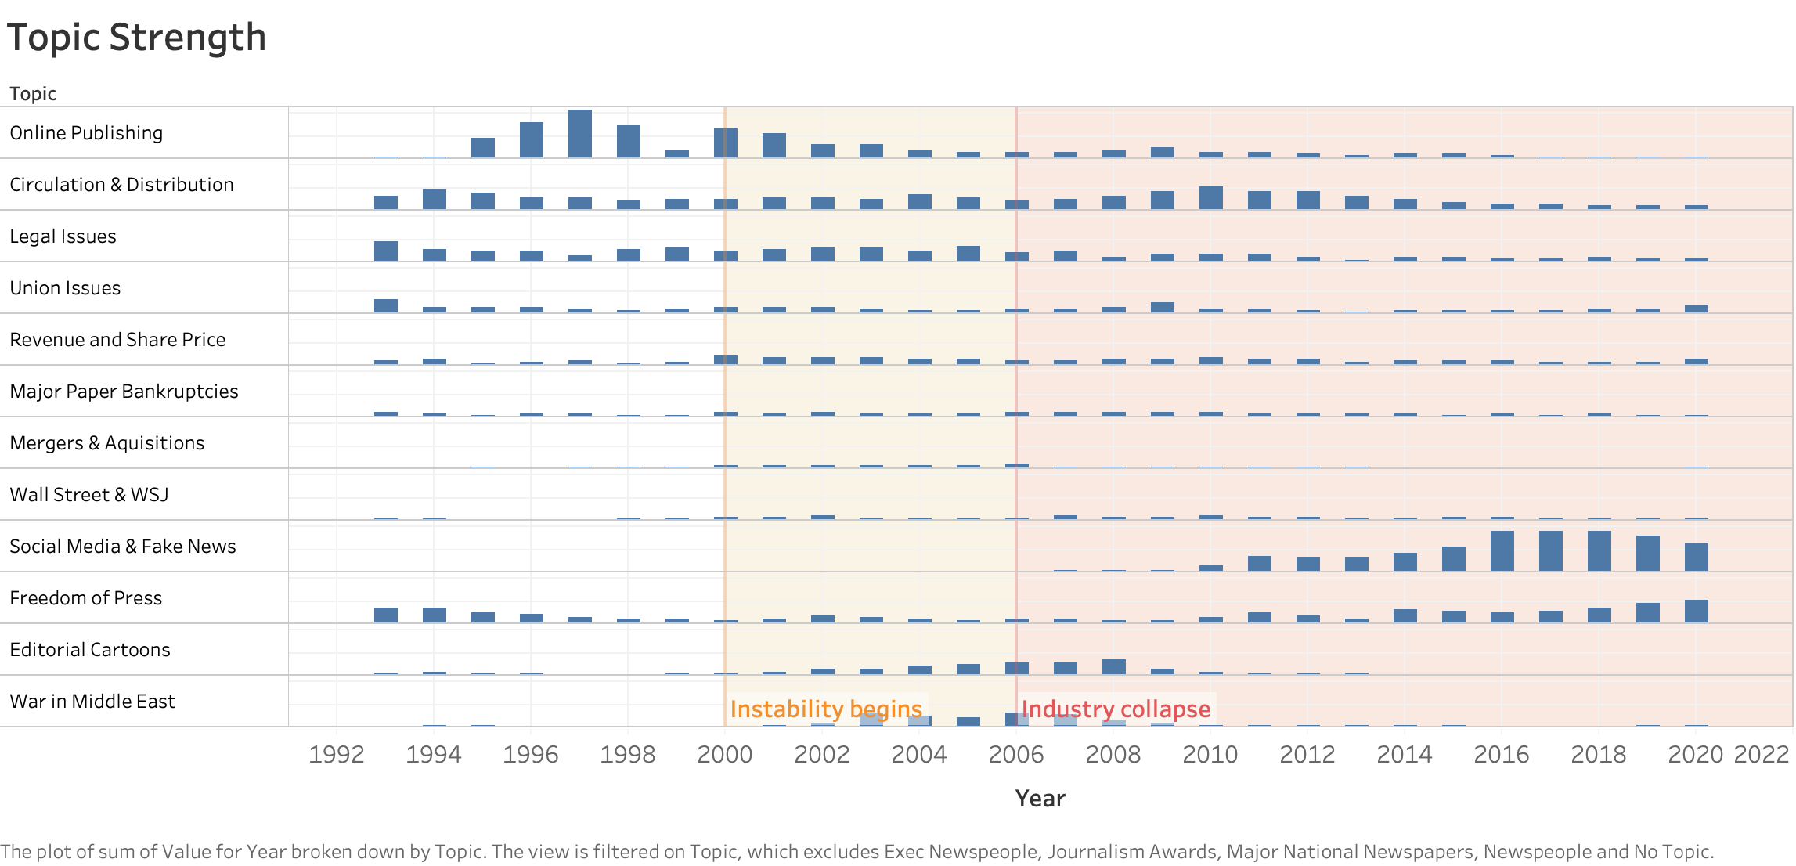
Results

Slide 8
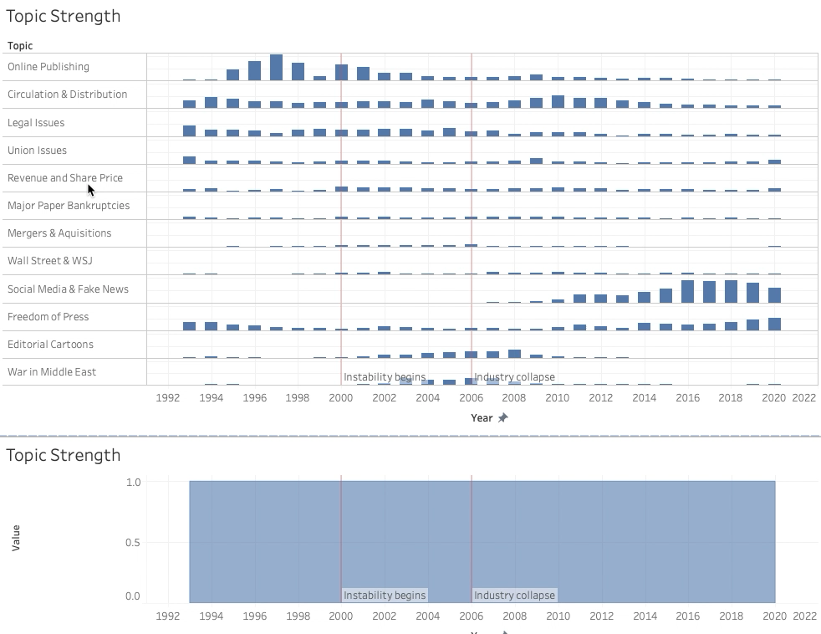
Results
Interactive dashboard

Slide 9
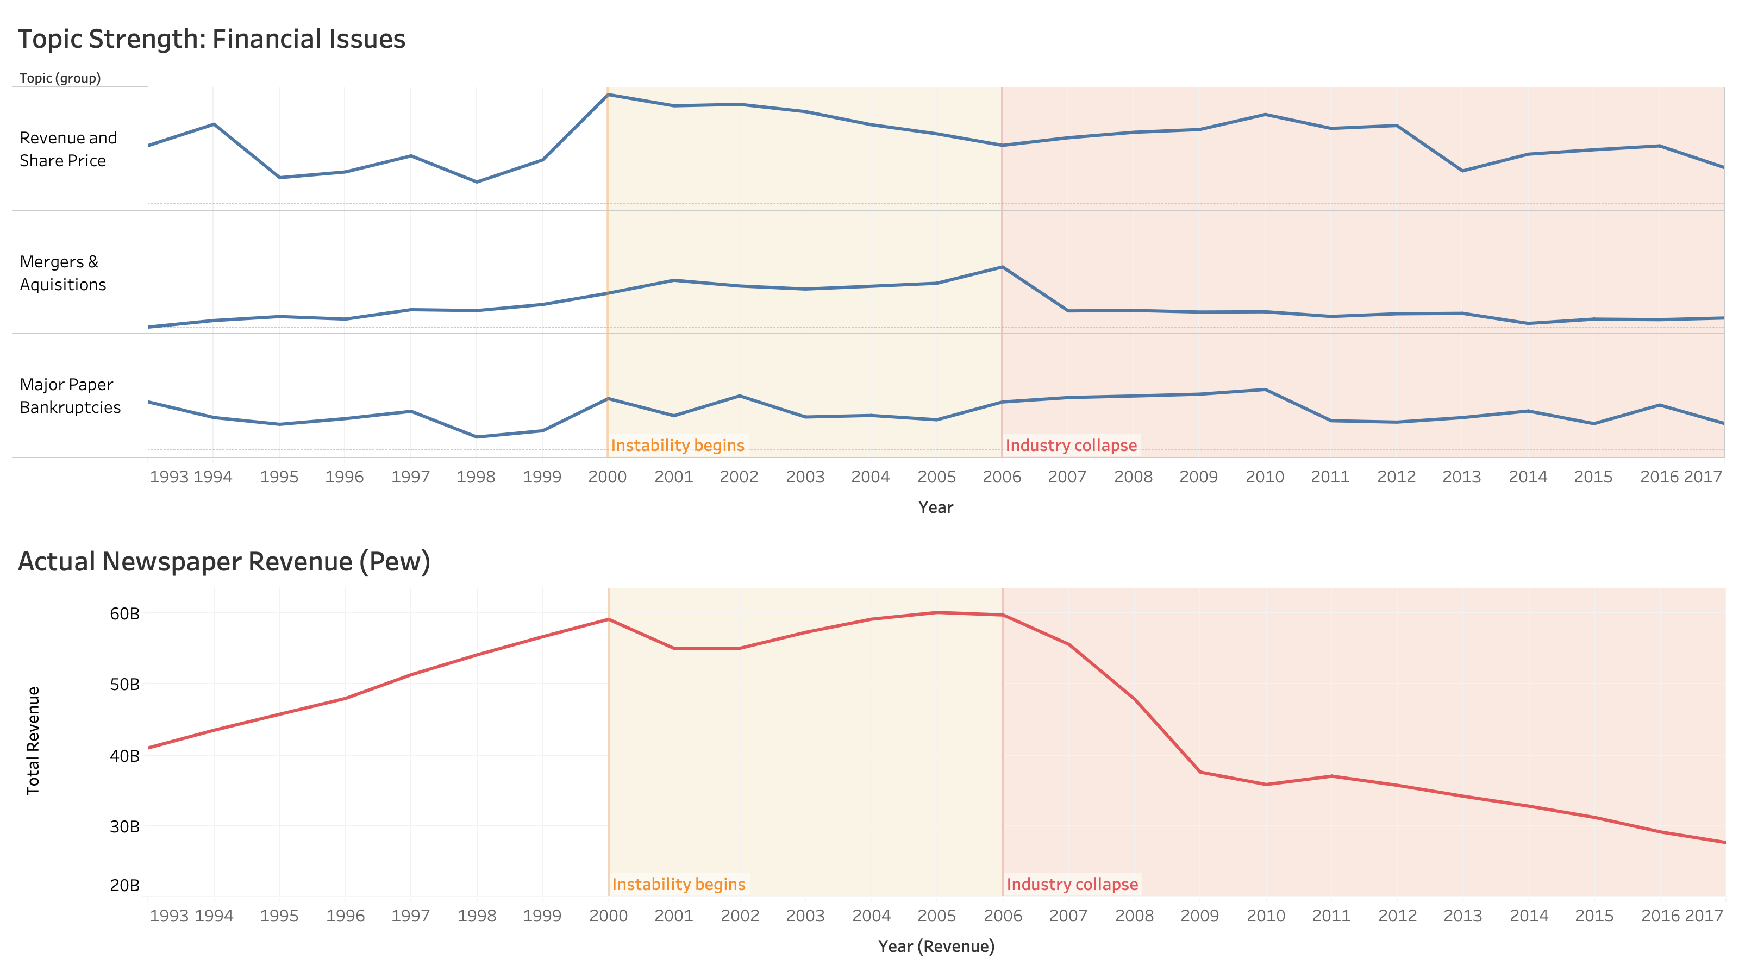

Slide 10
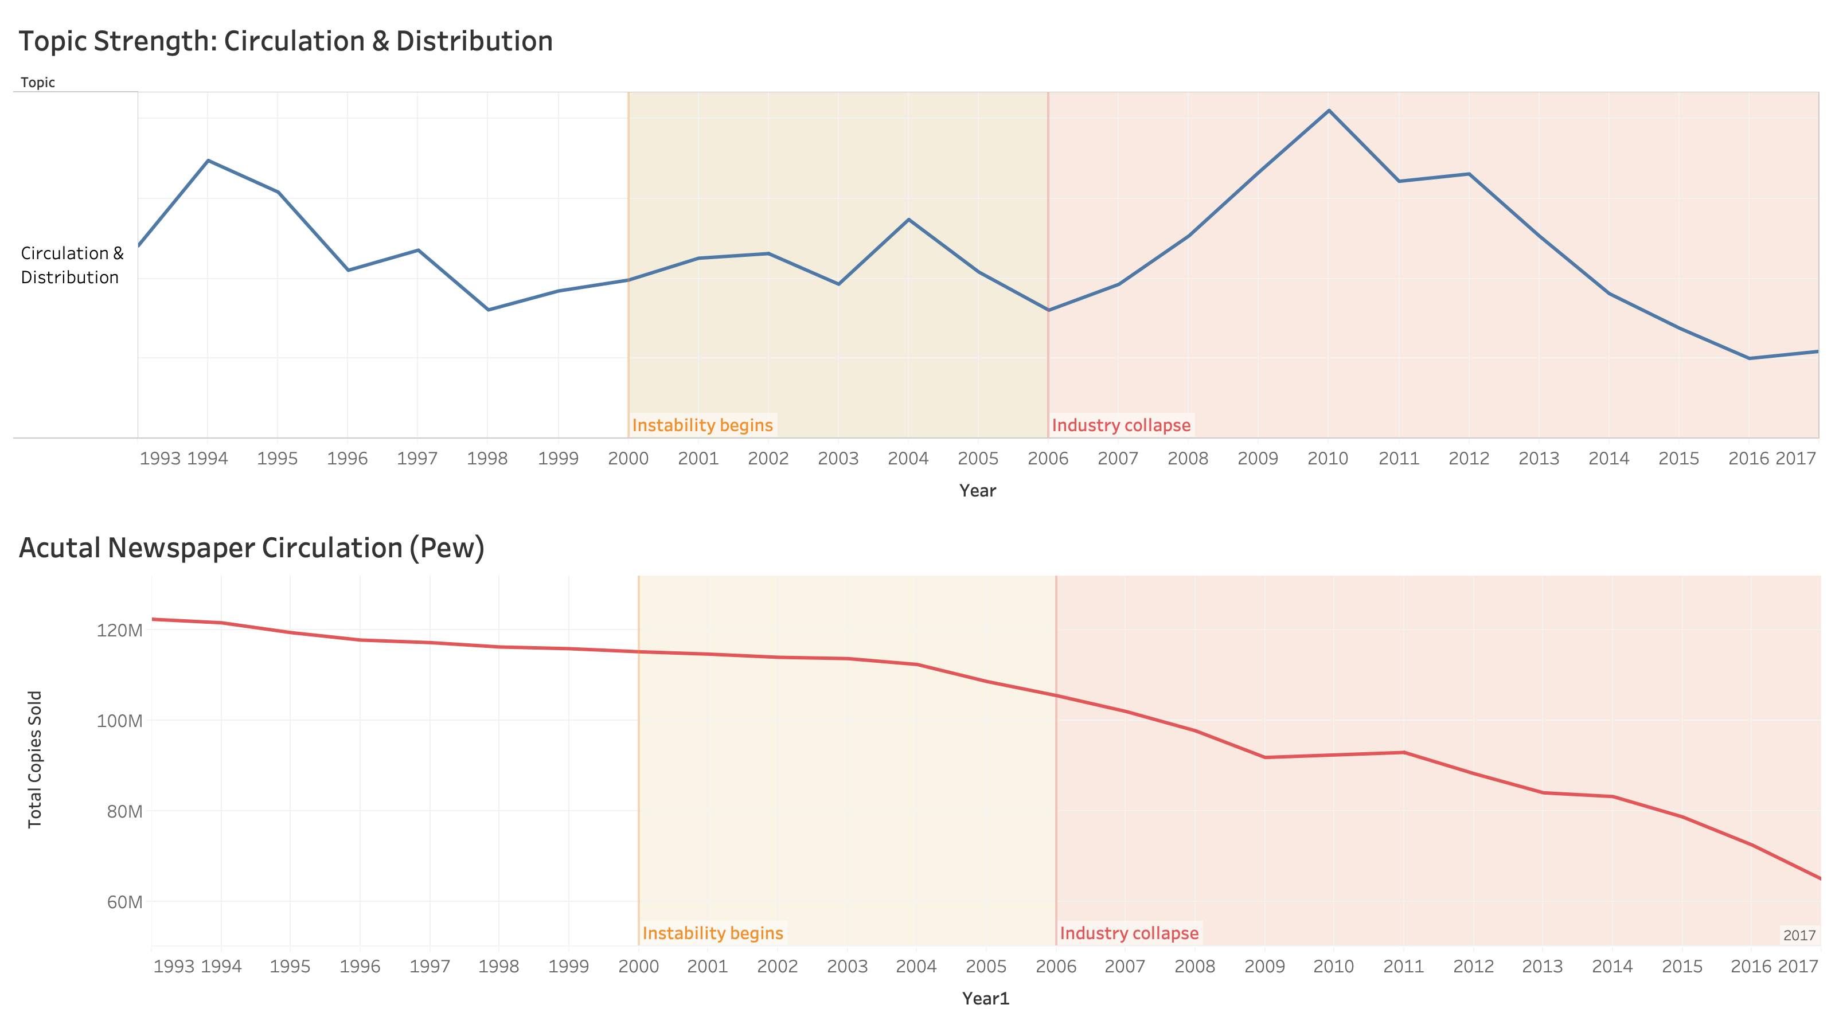

Slide 11
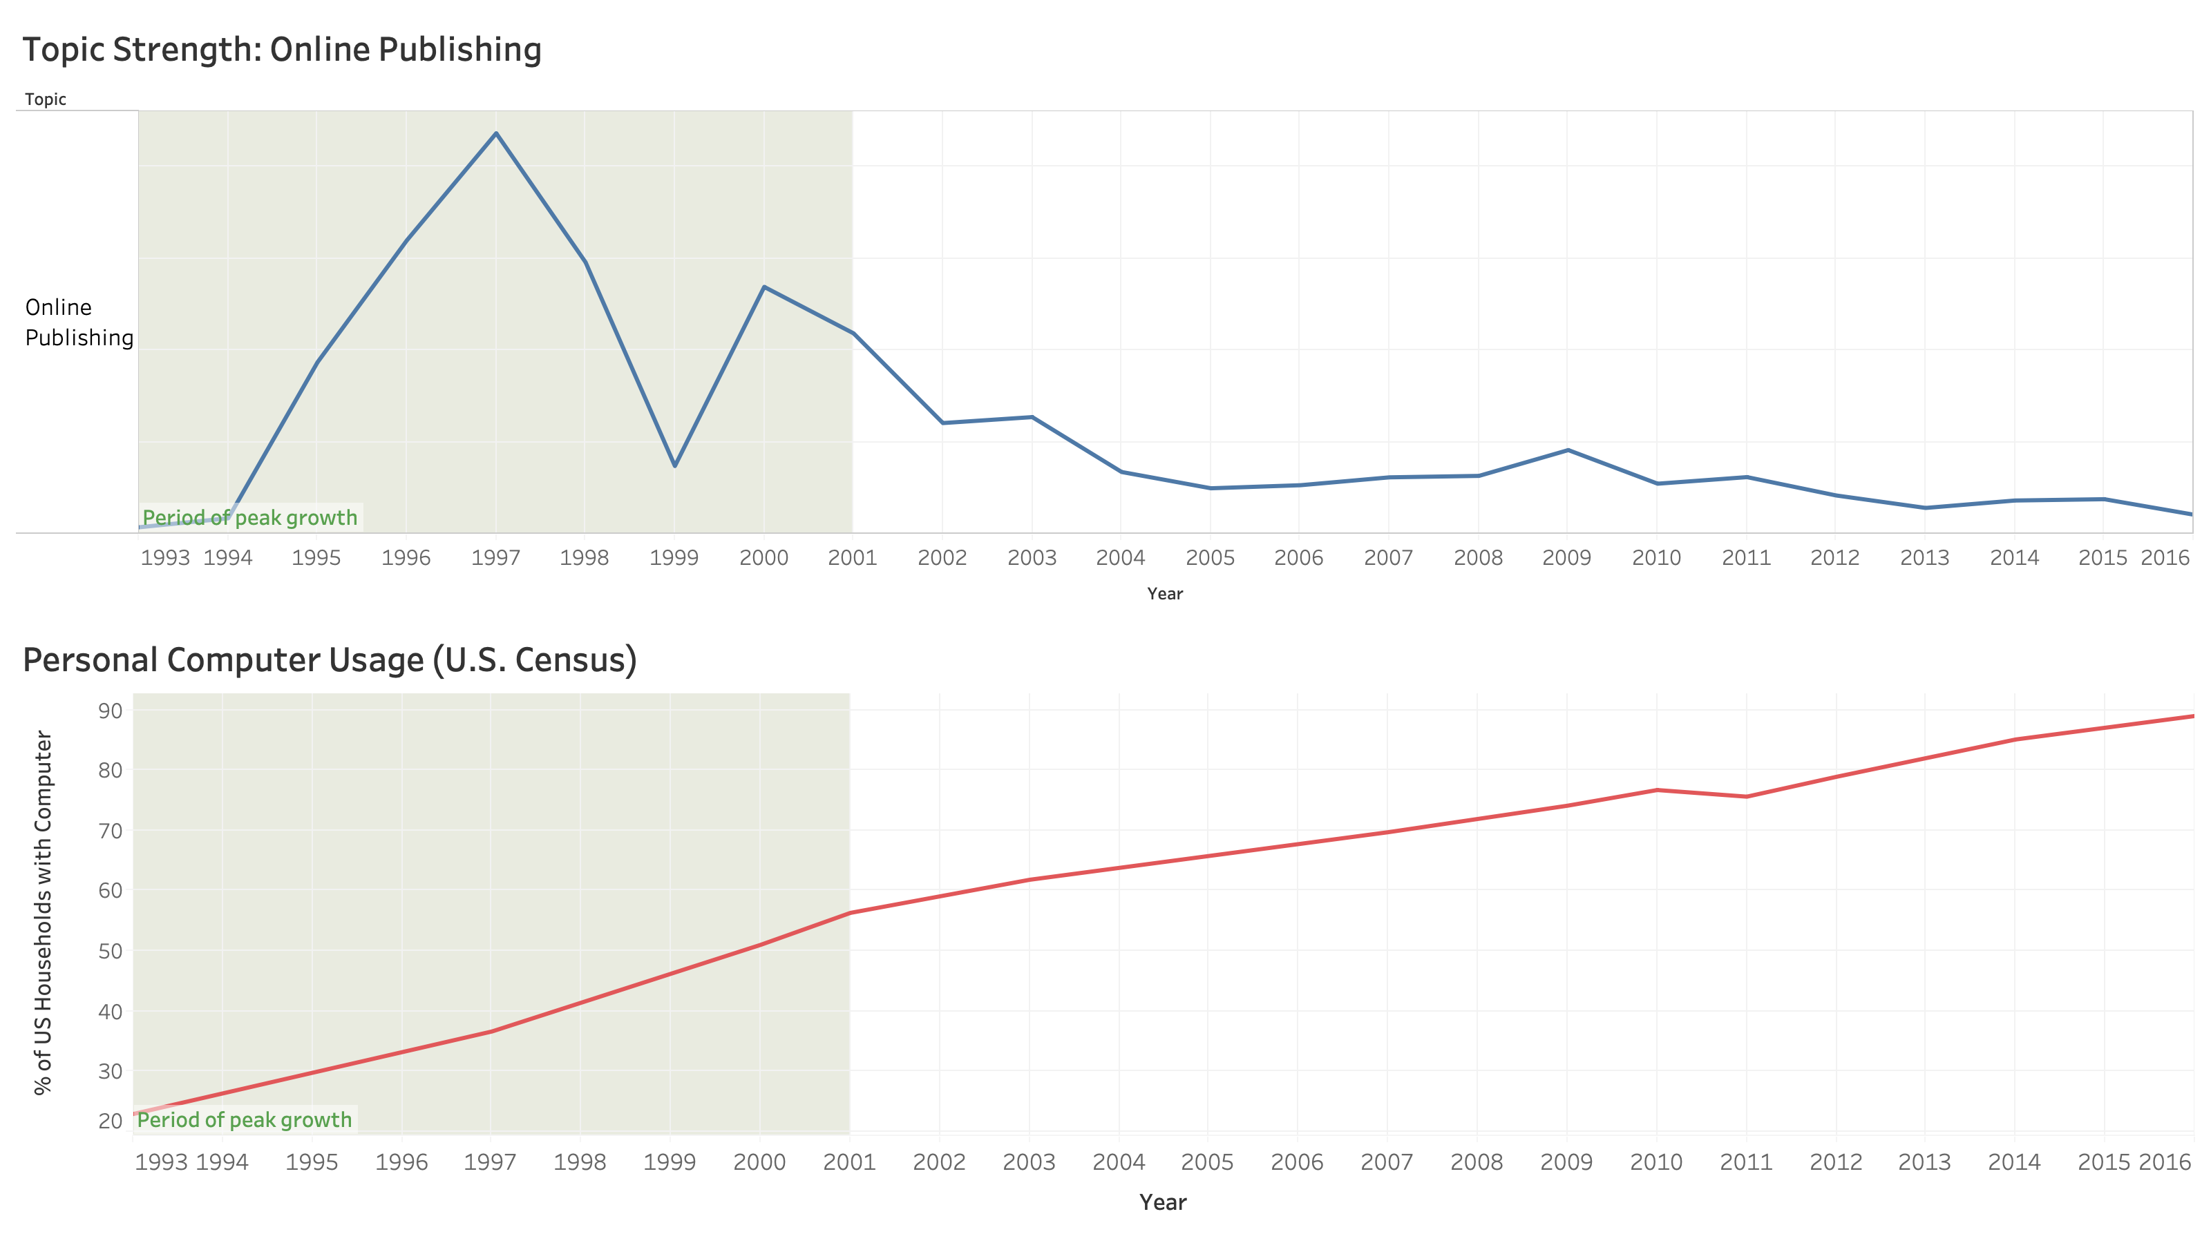

Slide 12
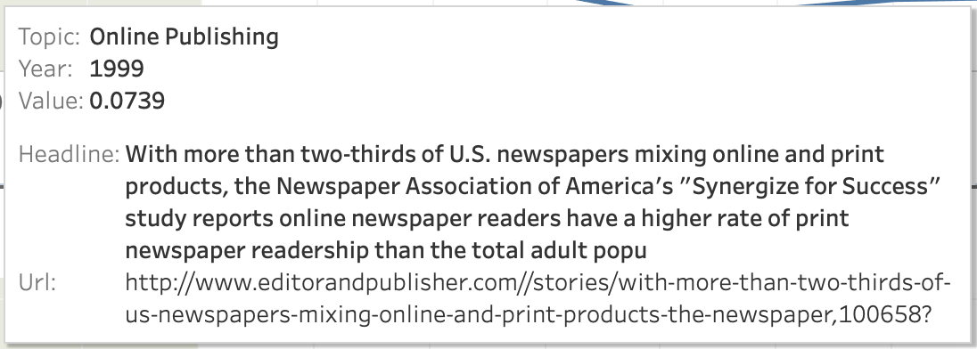

Slide 13
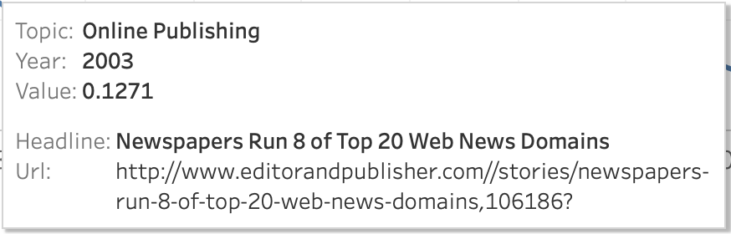

Slide 14
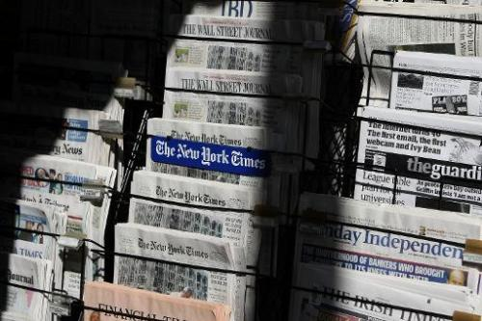
Conclusion
Key takeaways
Concern with key issues facing the industry can be quantified
Trending topics are closely tied with actual business conditions
Social media, fake news, and freedom of the press are increasingly important topics
Next Steps…
Improve topic assignment
Create real-time dashboard

Slide 15
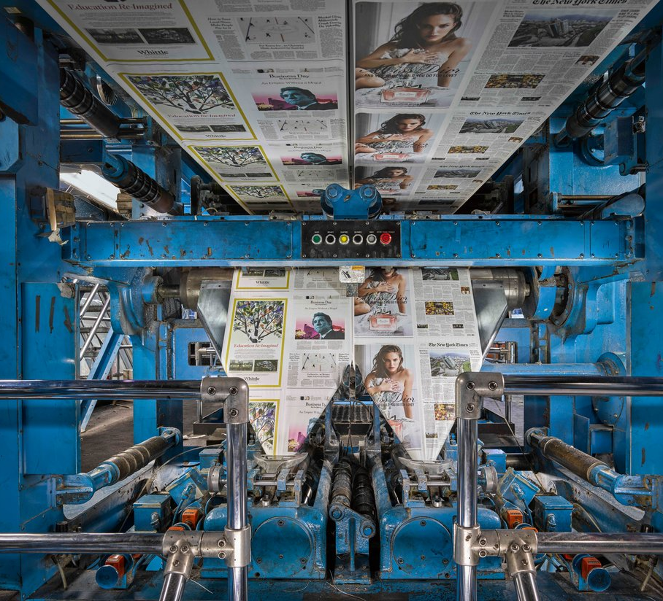
Appendix

Slide 16
MOST COMMON WORDS IN EACH TOPIC
REVENUE & SHARE PRICE: revenu, million, advertis, quarter, ad, cent, percent, advertis revenu, share, compani, ad revenu, increas, earn, year, declin, classifi,
MAJOR PAPER BANKRUPTCIES: tribun, chicago, lo angel, suntim, star tribun, compani, star, angel time, zell, , bankruptci, million, deal,media, chicago suntim, holling, debt, newsday, bid, stock, sam zell
NEWSPEOPLE: editor, manag editor, manag, sport, execut editor, publish, serv, daili, assist, editor publish, paper, execut, report, sport editor,
EDITORIAL CARTOONS: cartoonist, comic, cartoon, syndic, strip, editori, featur, creator, editori cartoonist, astor, king, univers, book, univers press, press syndic, editori cartoon,
EXEC. NEWSPEOPLE: presid, vice, publish, vice presid, media, compani, sale, director, market, group, manag, advertis, serv, execut, appoint, commun, senior
JOURNALISM AWARDS: journal, award, student, school, univers, commun, local, prize, winner, foundat, program, pulitz, project, public, colleg, year, honor, won,
WAR IN MIDDLE EAST: iraq, war, iraqi, militari, bush, troop, soldier, american, baghdad, kill, armi, death, forc, pentagon, offici, presid, marin,
ONLINE PUBLISHING: site, web, onlin, web site, content, internet, user, servic, ad, use, search, page, local, advertis, inform, provid, interact, link, access, offer, email, publish, print, launch, list, reader,
MAJOR NATIONAL NEWSPAPERS: york, new york, york time, post, washington, washington post, read new, globe, nyt, boston, report, magazin, york post, york citi, ny, daili news, read, boston globe
SOCIAL MEDIA & FAKE NEWS: facebook, read, video, media, social, digit, platform, content, app, publish, googl, mobil, social media, twitter, user, read facebook, audienc, fake, data, fake news,
LEGAL ISSUES: court, judg, case, rule, law, attorney, feder, file, report, appeal, investig, lawsuit, trial, black, public, record, inform, state
FREEDOM OF PRESS: journalist, report, press, media, freedom, govern, kill, read, polic, arrest, press freedom, countri, organ, cover, group, attack, trump, protest, world, investig, associ, protect
UNION ISSUES: union, guild, employe, contract, cut, paper, newsroom, worker, buyout, job, layoff, newspap guild, vote
WALL STREET & WSJ ACQUISITION: jone, dow, dow jone, journal, wall, wall street, street journal, street, murdoch, news corp, corp, wsj, rupert, compani, bancroft, rupert murdoch, stock
CIRCULATION & DISTRIBUTION: print, paper, daili, circul, press, product, edit, publish, goss, copi, sunday, weekli, plant, color, reader, instal, free, plate, page, distribut, deliveri, custom, daili news, oper,
MERGERS & ACQUISITIONS: ridder, knight, knight ridder, mcclatchi, compani, san, gannett, san jose, jose, philadelphia, stock, medianew, mercuri, mercuri news, paper, deal, bid
NO TOPIC: hi, say, stori, peopl, like, think, column, obama, just, paper, know, dont, want, day

Slide 17
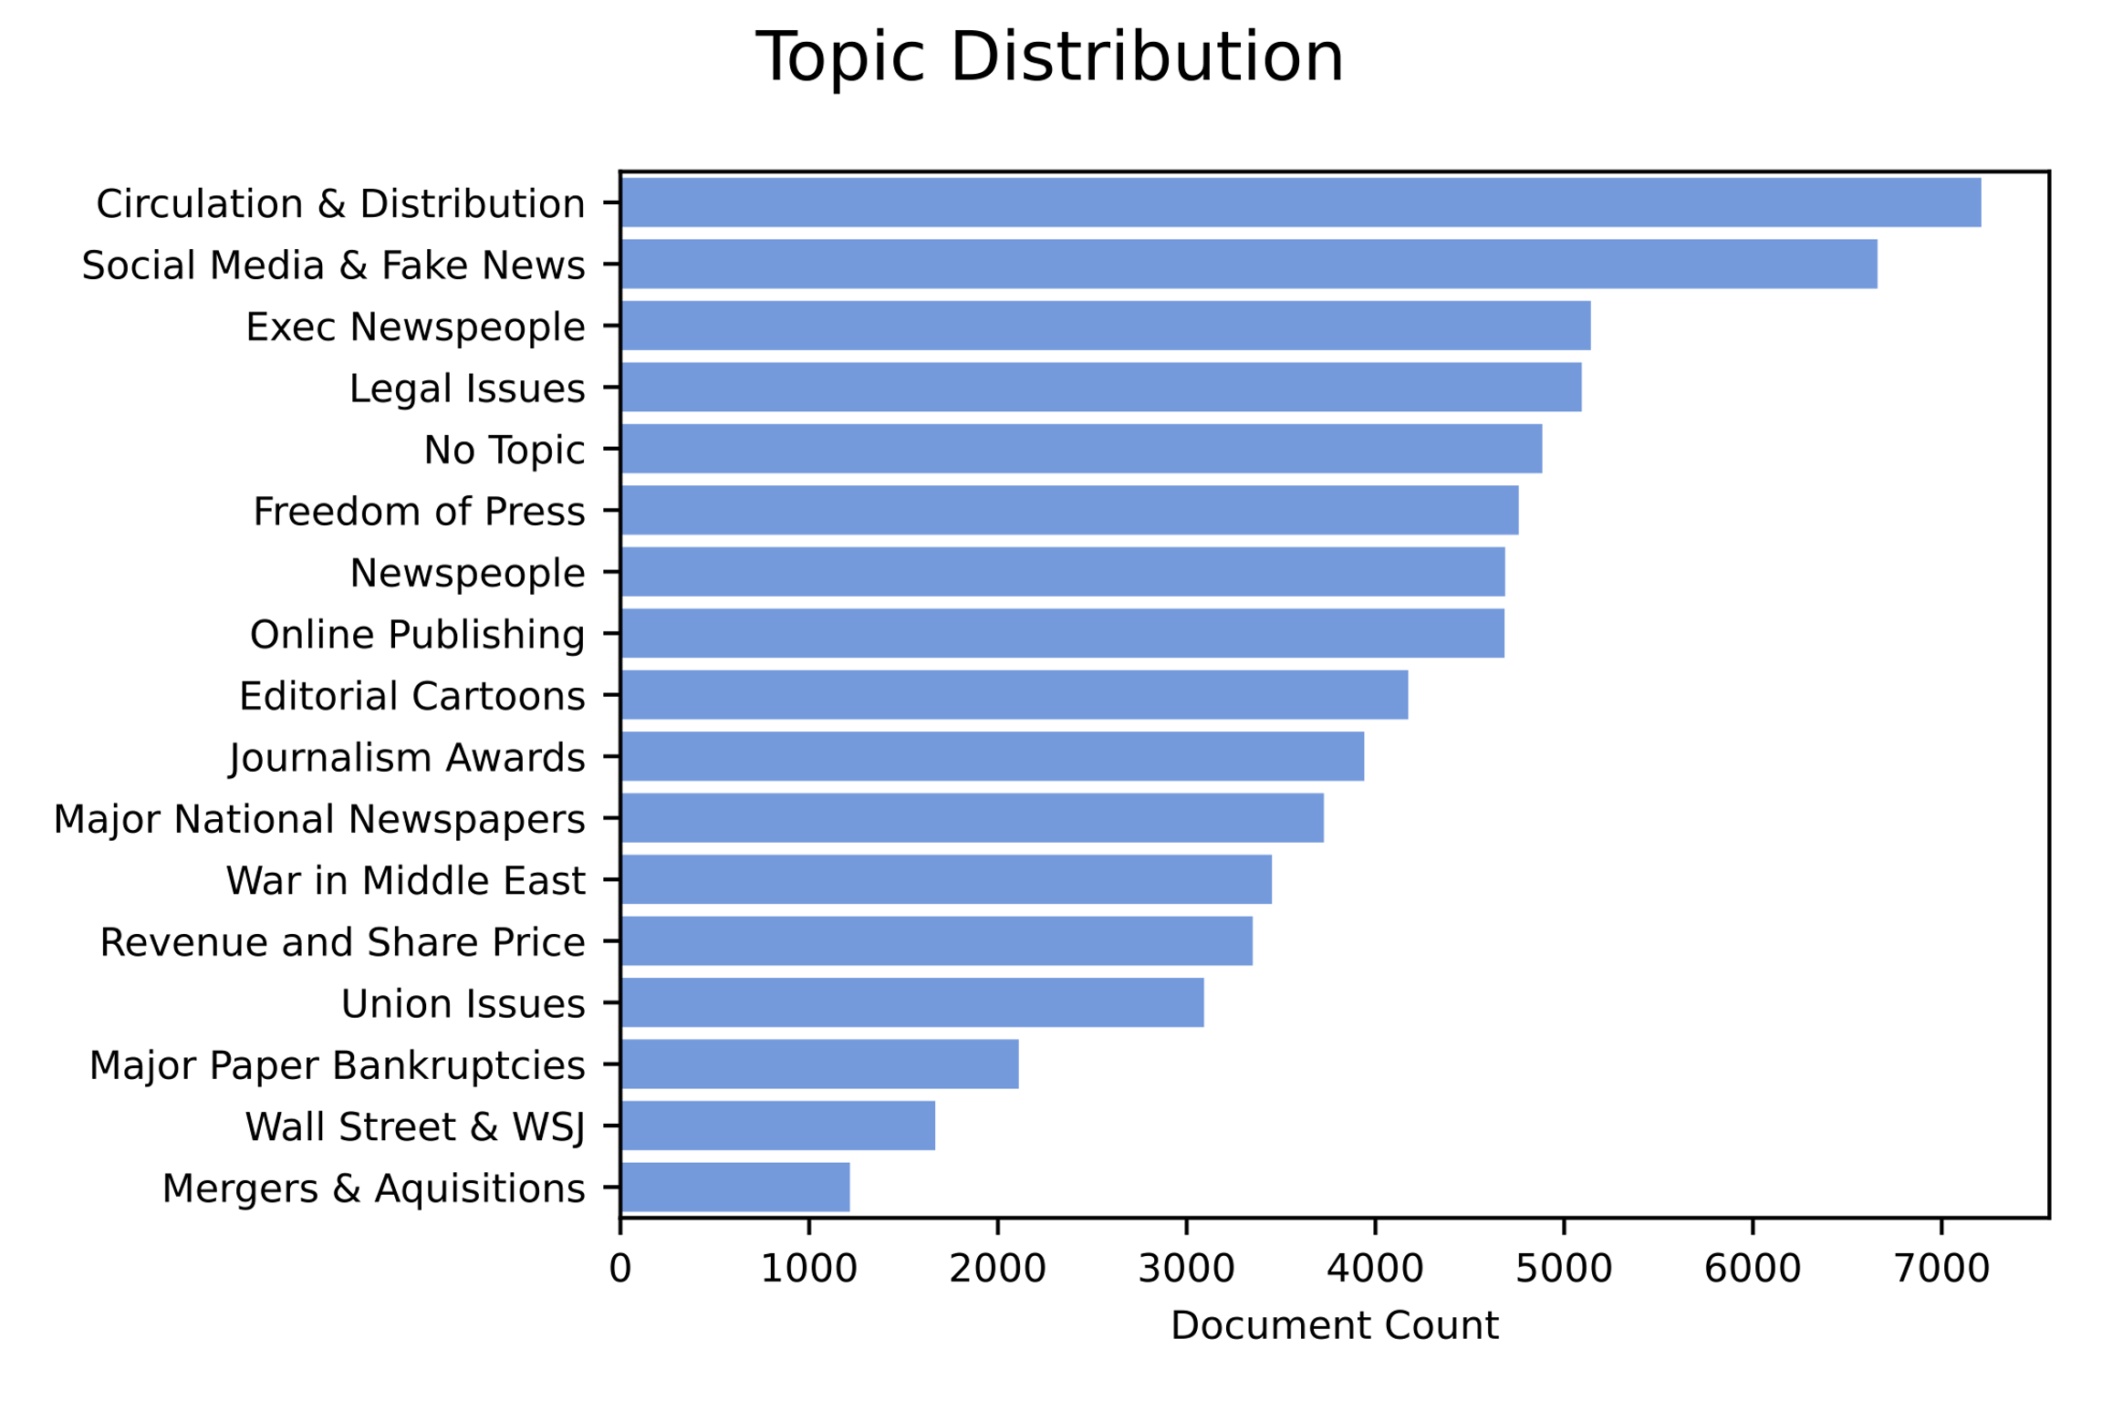
All-time Topic Distribution

Slide 18
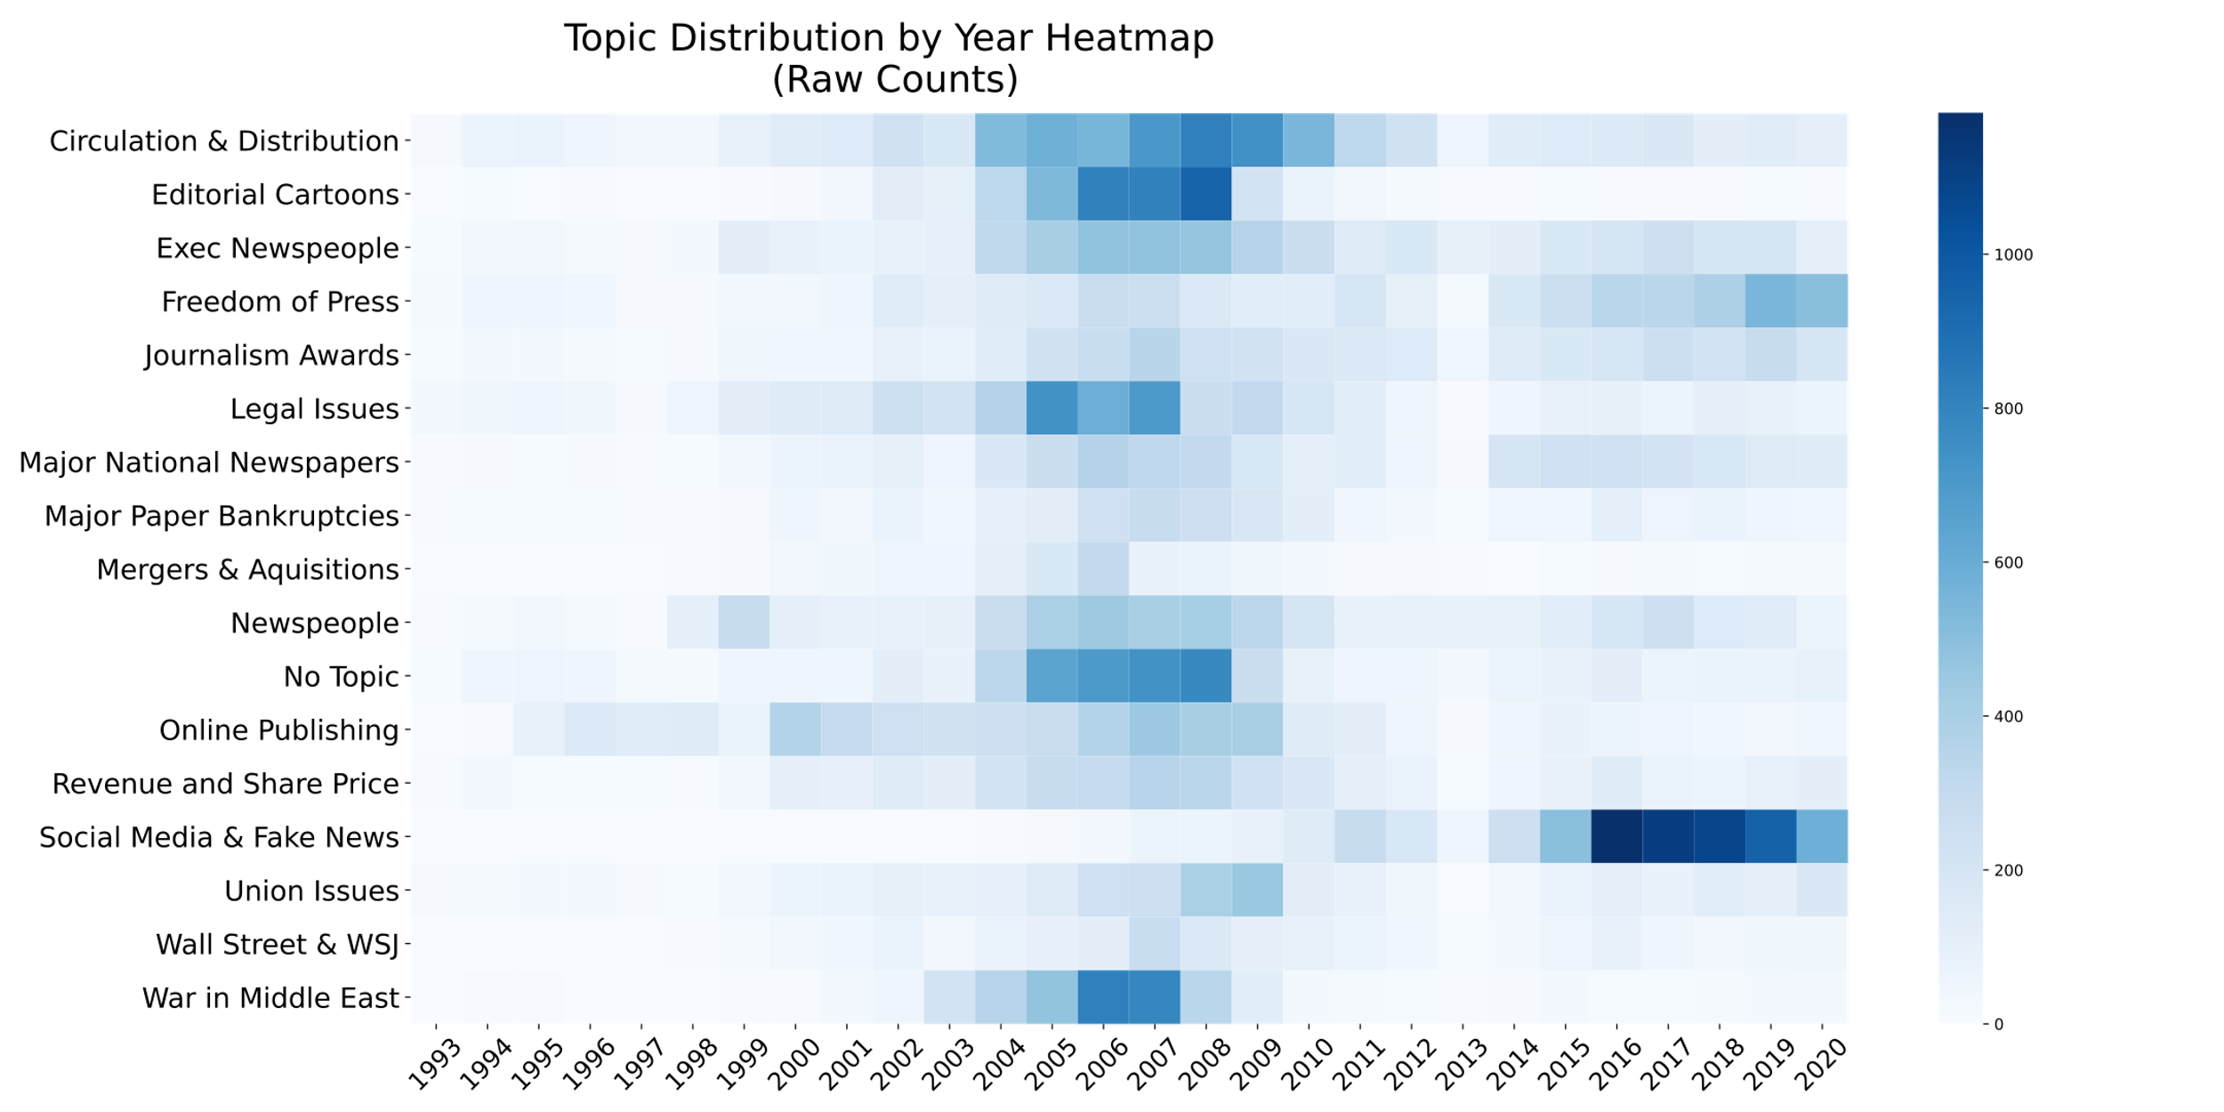
Topic Popularity by Year
Topic distribution over time without pre-normalization

Slide 19
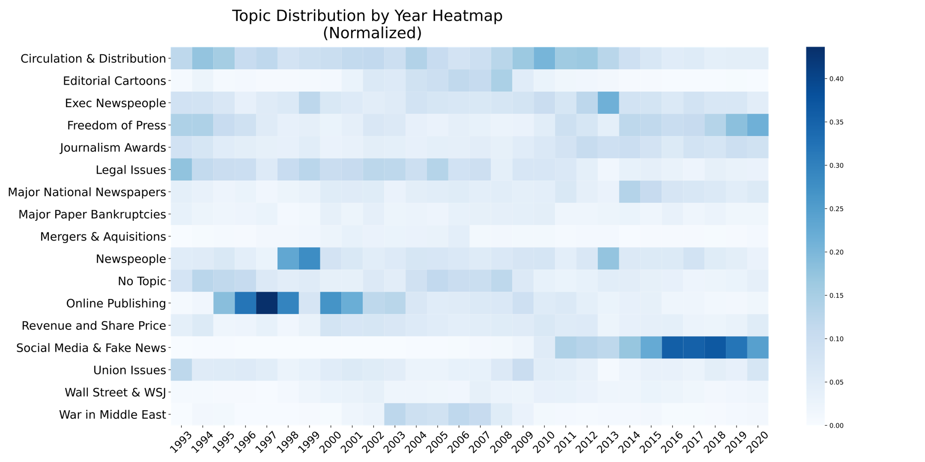
Topic Popularity by Year
Topic distribution over time after pre-normalization

Slide 20
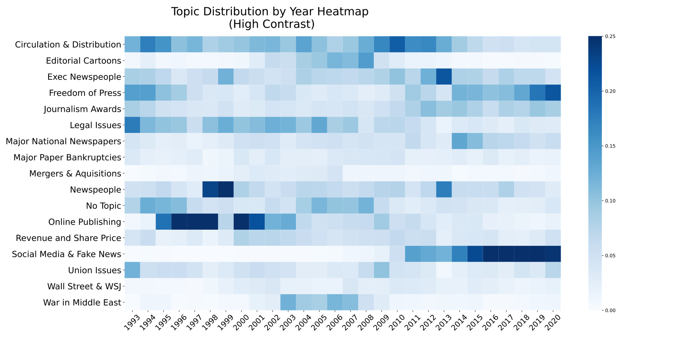
Topic Popularity by Year
Topic distribution over time after pre-normalization, with color balanced shifted to highlight less popular topics

Slide 21
